Slide 1


Status Report TTbar resonances Angular Distributions NTUA
George Bakas

Slide 2
Status Report
DCS:
CMSfwInstallUtils
ConfDbChecks: Difficult to find a generic way to check configs between db and project
Thinking of just giving the user the opportunity of actually checking inconsistency between project and db for inconsistent dpes
fwInstallationUtils
dbEditor and Navigator is ready to deploy
Checking on how to improve the tool in some ways (faster initialization etc)
Analysis
Angular Distributions
Efficiencies and Acceptance for top Tagger vs DeepAK8 vs old Event MVA tagger

Slide 3
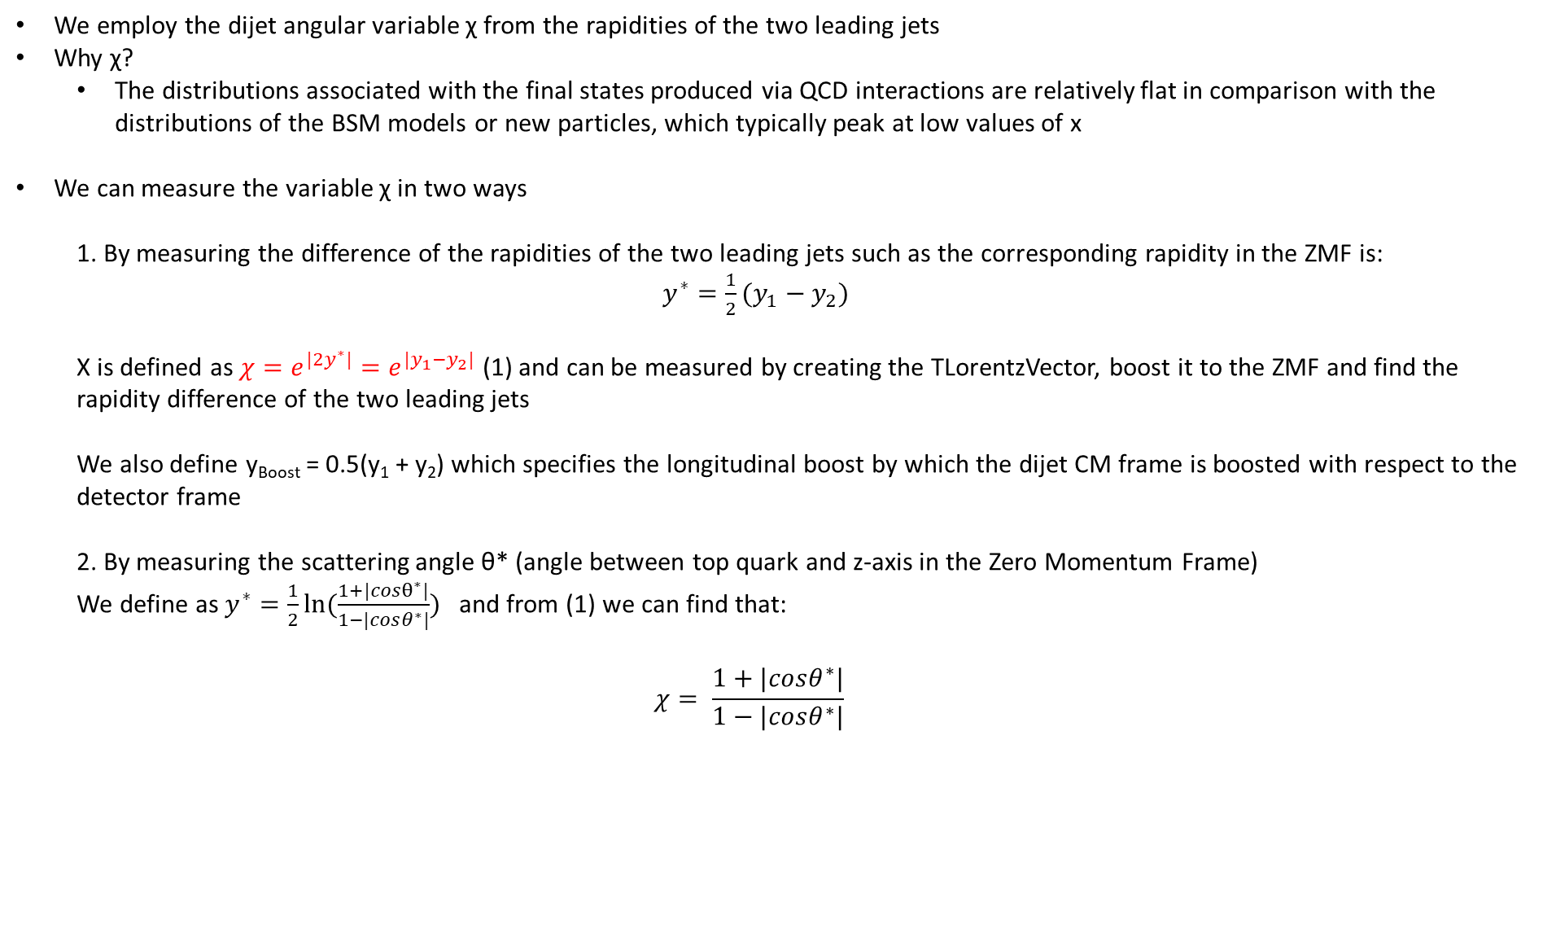
Variables
We employ the dijet angular variable χ from the rapidities of the two leading jets
Why χ?
The distributions associated with the final states produced via QCD interactions are relatively flat in comparison with the distributions of the BSM models or new particles, which typically peak at low values of x
We can measure the variable χ in two ways
1. By measuring the difference of the rapidities of the two leading jets such as the corresponding rapidity in the ZMF is: $y^{∗}=\frac{1}{2}(y_{1}−y_{2})$
Χ is defined as $χ=e^{{|2y}^{∗}|}=e^{|y_{1}−y_{2}|}$ (1) and can be measured by creating the TLorentzVector, boost it to the ZMF and find the rapidity difference of the two leading jets
We also define y_{Boost} = 0.5(y₁ + y₂) which specifies the longitudinal boost by which the dijet CM frame is boosted with respect to the detector frame
2. By measuring the scattering angle θ* (angle between top quark and z-axis in the Zero Momentum Frame)
We define as $y^{∗}=\frac{1}{2}ln⁡(\frac{1+|cosθ^{∗}|}{1−|cosθ^{∗}|})$ and from (1) we can find that:
$$χ= \frac{1+|cosθ^{∗}|}{1−|cosθ^{∗}|}$$

Slide 4
Response Matrices
Selection:
Parton: partonPt > 500*, |partonEta|< 2.4, mTTbarParton > 1000
Reco: jetPt>500, |jetEta| < 2.4, nLeptons ==0
Btagging Medium working point
Top tagger mva > 0.3
Jet mass soft Drop (120, 220)GeV
Jets are matched
Response matrix of χ_{reco}, χ_{parton} with {1,2,3,4,5,6,8,10,13,16} as variable binning
The same binning is then used to find the response matrices in different mass (mTTbar) regions
[1000-1600]GeV
[1600-2200]GeV
[2200-3000]GeV
[3000-3600]GeV
[3600-6000]GeV
Stability, Efficiency for χ distribution
Acceptance and purity for χ
*By applying the Pt to be more than 500, we get more similar results with ATLAS

Slide 5
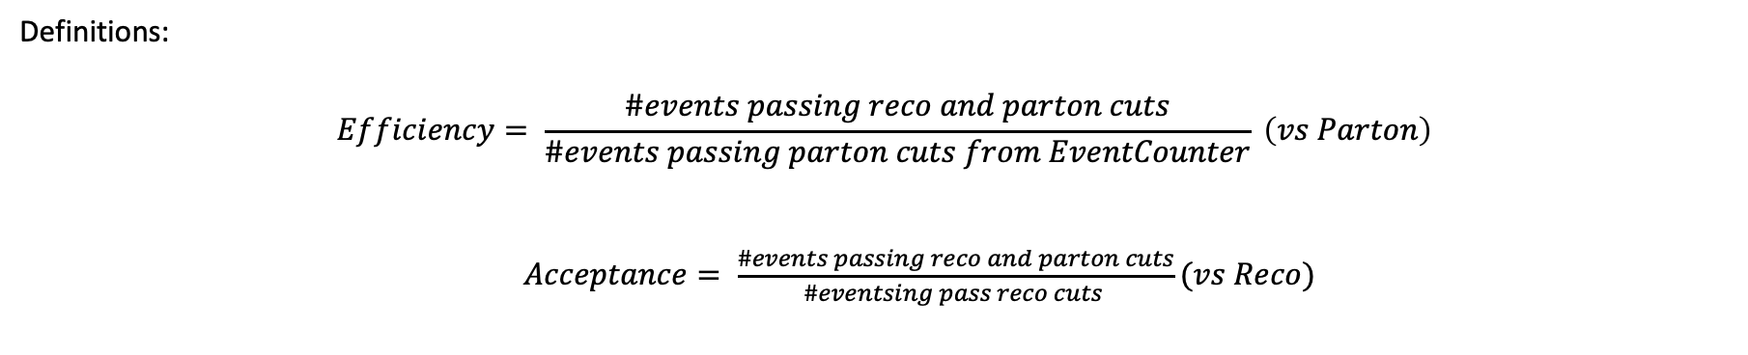
Response Matrices
Selection:
Jet Matching
Parton cuts:
partonPt[0],[1] > 400
|partonEta[0],[1]| < 2.4
mTTbarParton > 1000
Reco cuts:
nJets > 1
nLeptons = 0
mJJ > 1000
jetPt[0],[1] > 400
|jetEta[0],[1]| < 2.4
bTagging (Medium WP)
Tagger cut (event mva, top Tagger, deepAK8)
JetMassSoftDrop > 120 and < 220
Definitions:
$$Efficiency= \frac{\#events passing reco and parton cuts}{\#events passing parton cuts from EventCounter} \left(vs Parton\right)$$
$Acceptance= \frac{\#events passing reco and parton cuts}{\#eventsing pass reco cuts }(vs Reco)$

Slide 6
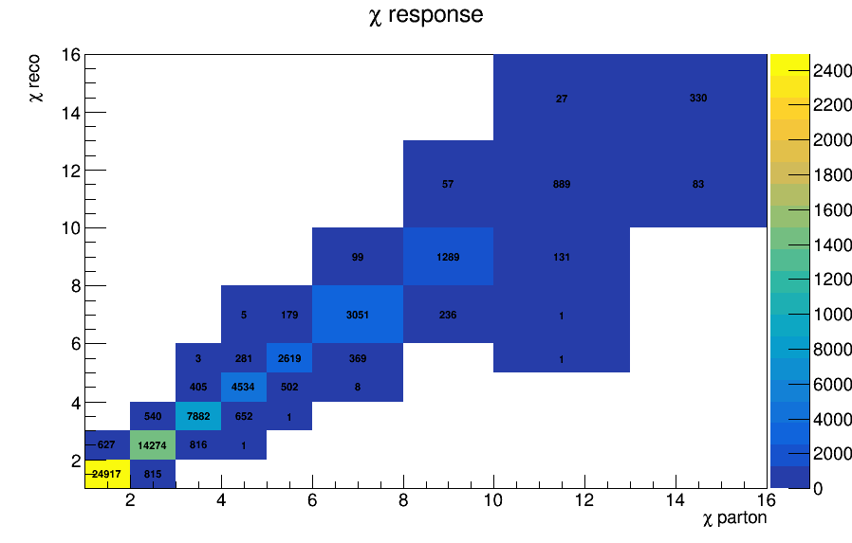
Response Matrix for χ

Slide 7
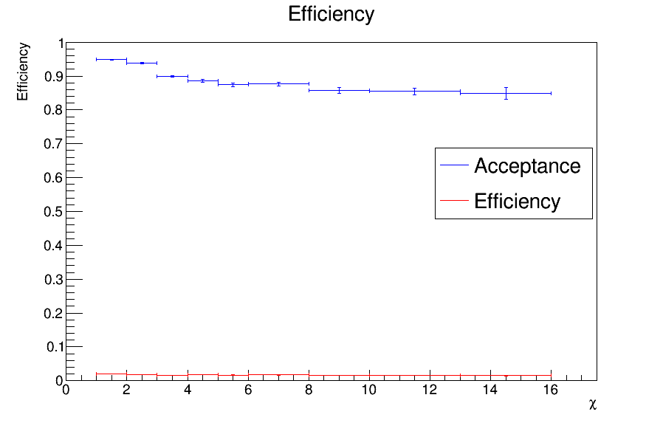
Efficiency and Acceptance for chi distribution

Slide 8
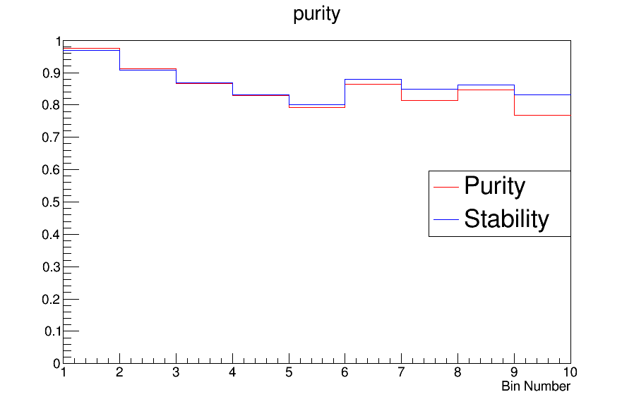
Purity and Stability for chi distribution

Slide 9
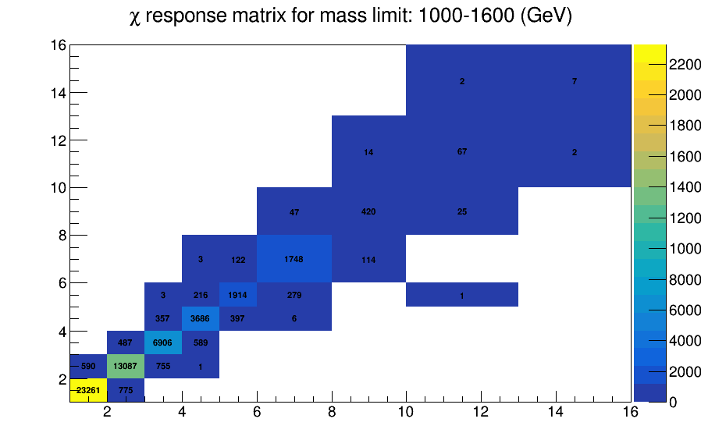
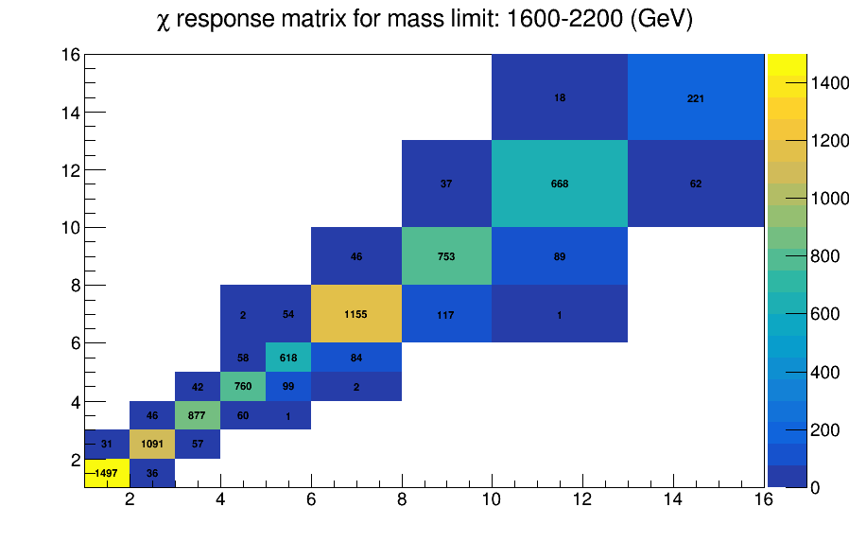

Slide 10
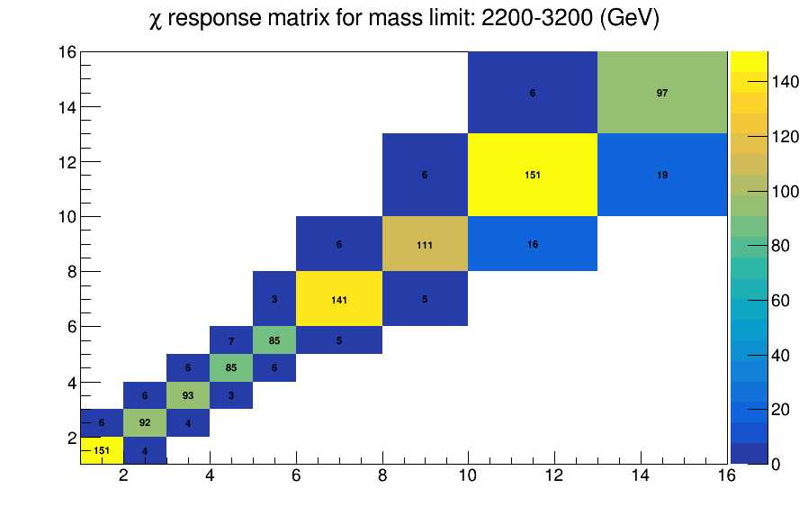
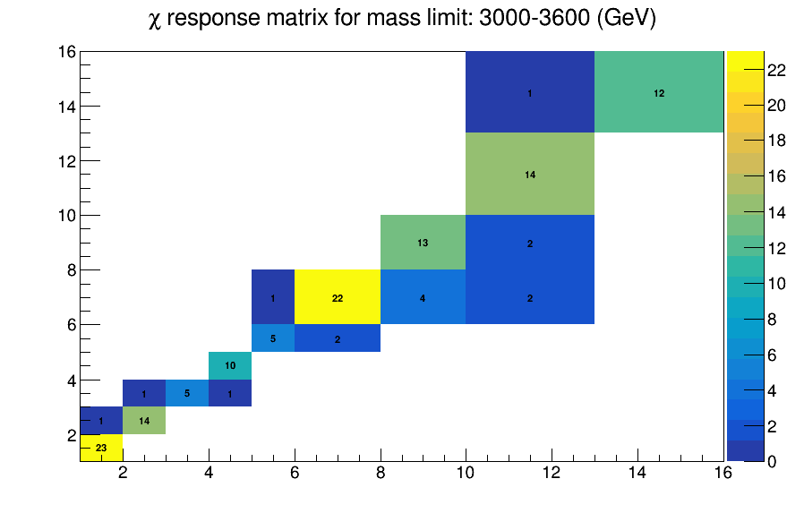

Slide 11
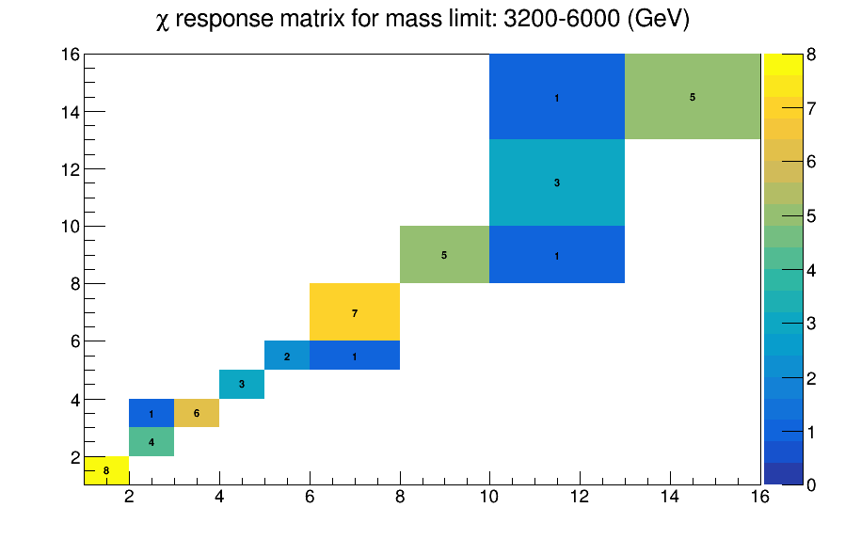

Slide 12
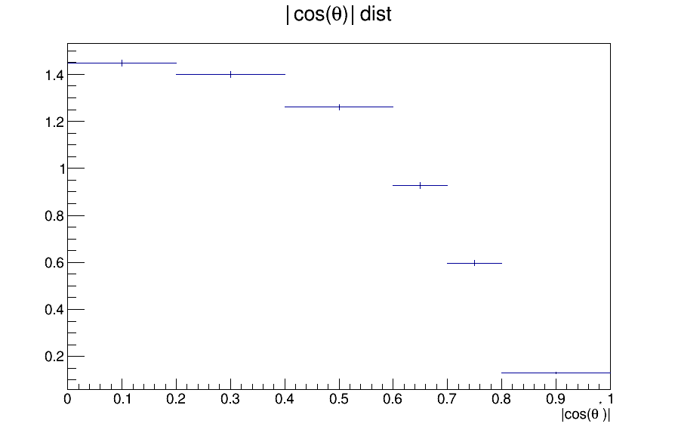
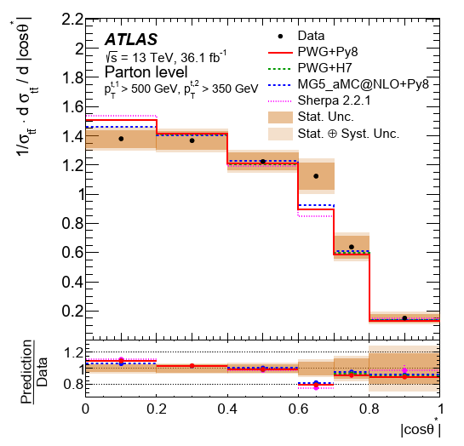
Comparisons with ATLAS |cosθ| distributions

Slide 13
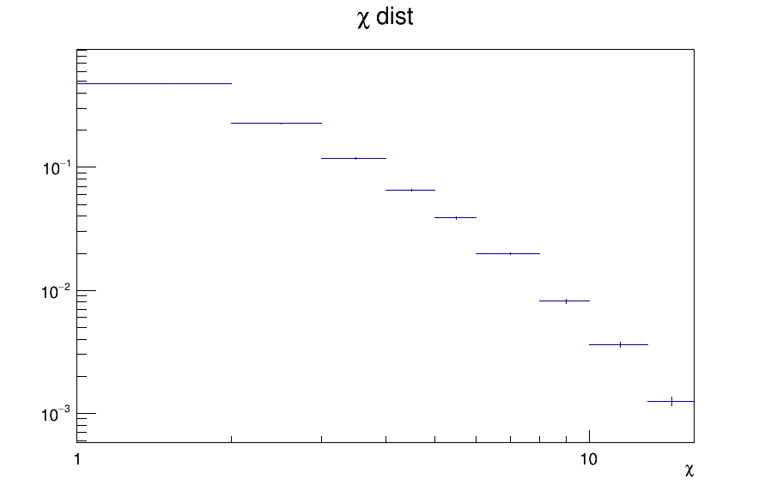
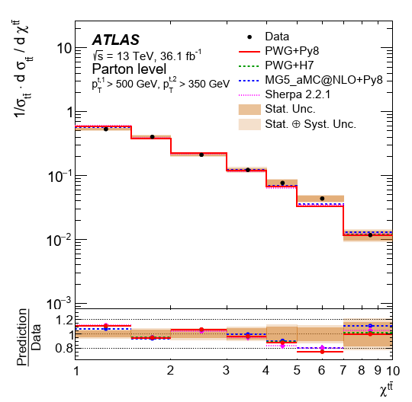
Comparisons with ATLAS χ distributions

Slide 14
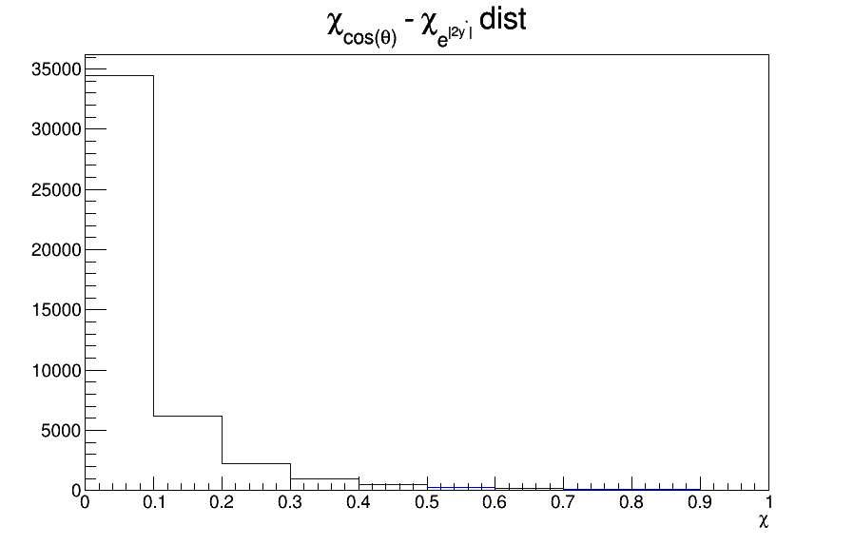

Comparison on how to measure x value
$e^{\left|2y^{∗}\right|}$
$χ= \frac{1+|cosθ^{∗}|}{1−|cosθ^{∗}|}$

Slide 15
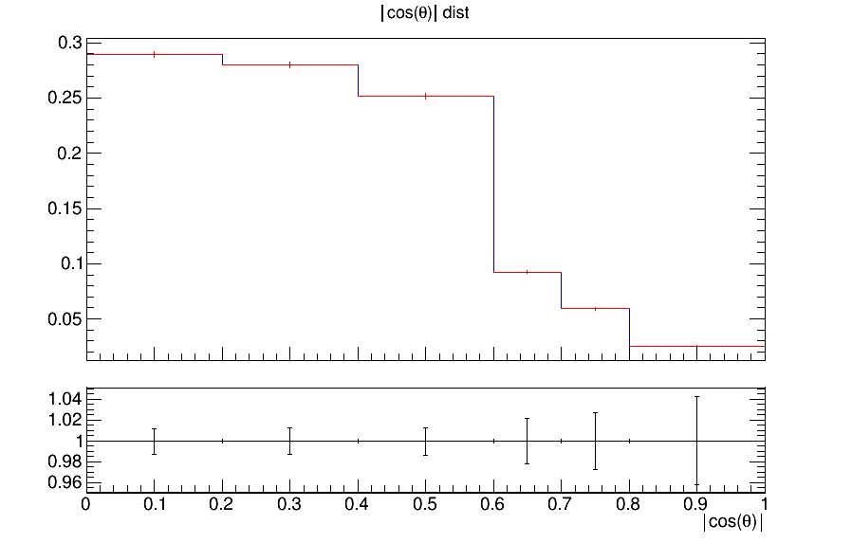
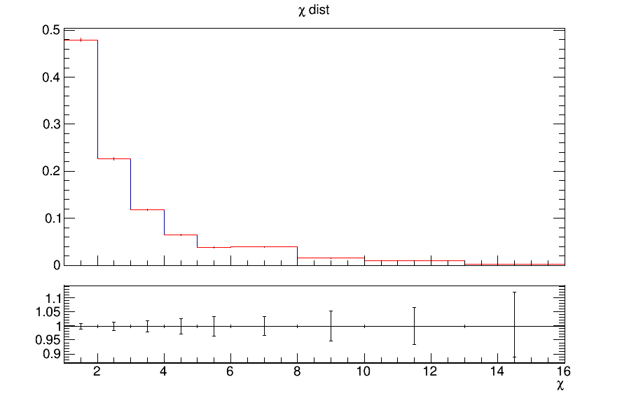
QCD Measurement vs Search
In exotica searches, an |y_{Boost}|<1.19 cut is applied
Are there any differences when we don’t aply the cut?
|cosθ| With boost cut
χ With boost cut
|cosθ|
χ

Slide 16
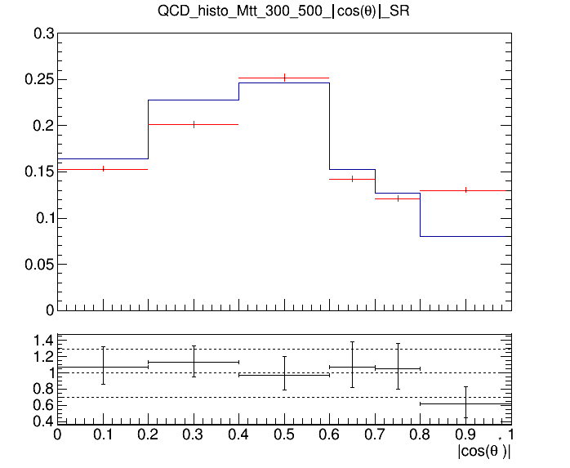
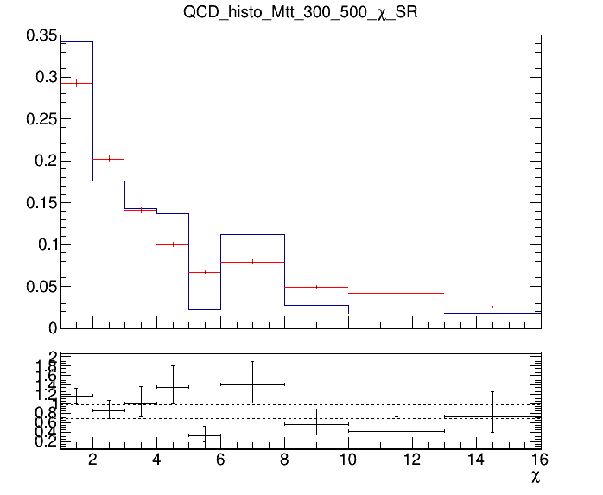
QCD Background MC closure tests
Closure test for QCD samples in Control Region (SR with reverted btagging cut (btag==0))
Control Region (0-btag)
Control Region (0-btag)
Signal Region (2-btag)
Signal Region (2-btag)

Slide 17
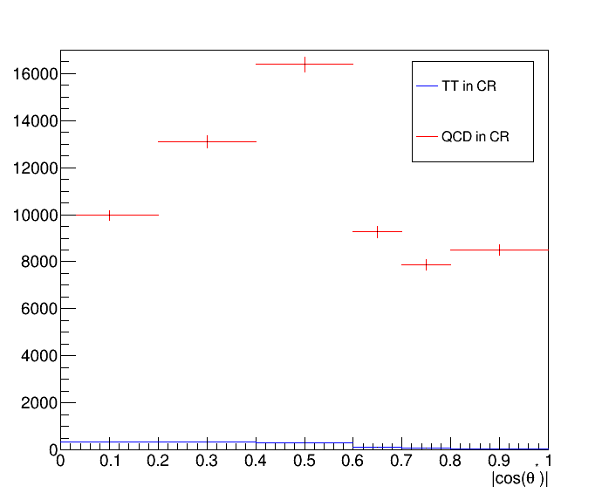
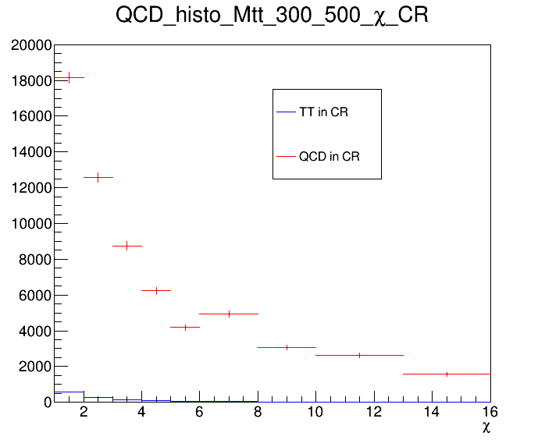
Control Region Contamination
Expected yield from MC samples and TT sample in the CR

